Slide 1
GAME CONCEPTS PITCH
Introducing unique gameplay ideas and market opportunities
Notes:
--- This presentation introduces three innovative game concepts, showcasing their unique gameplay, target audiences, and market potential. We will explore each concept’s core features, monetization strategies, and opportunities for expansion.

Slide 2
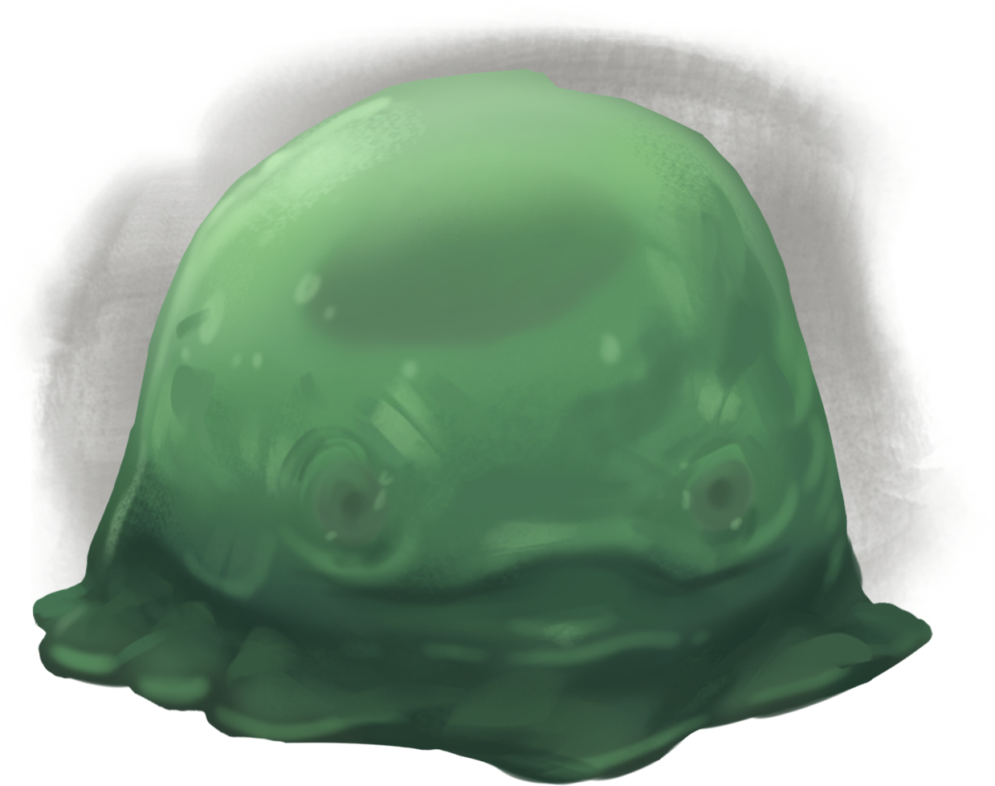
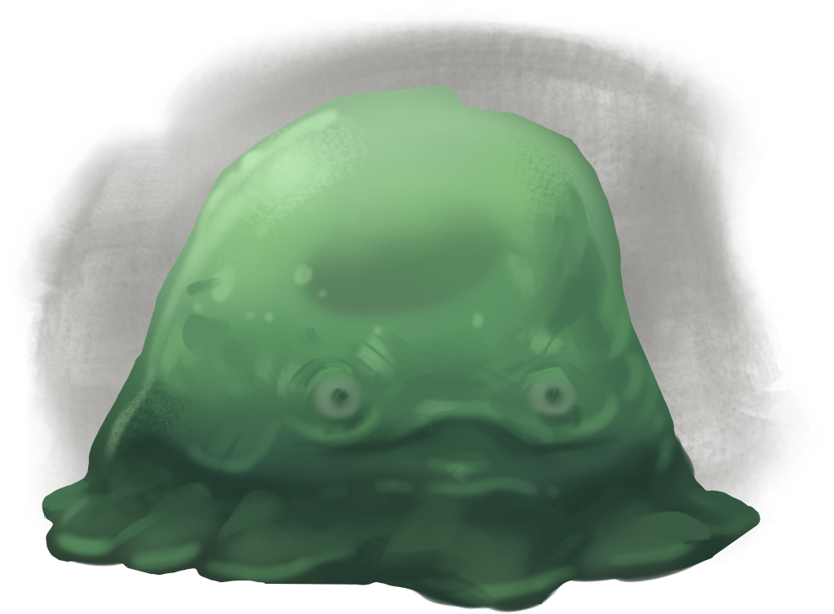
Game Concept 1: ‘mass of slime’
Agar.io meets SlimeRancher
Absorb
Split
Dash
TWIST:
Small = Fast, high DPS, fragile
Large = Tanky, slow, low DPS
WIN: overheat robot -> core opens -> strike.
LOSE: shredded and lose all your mass

Slide 3
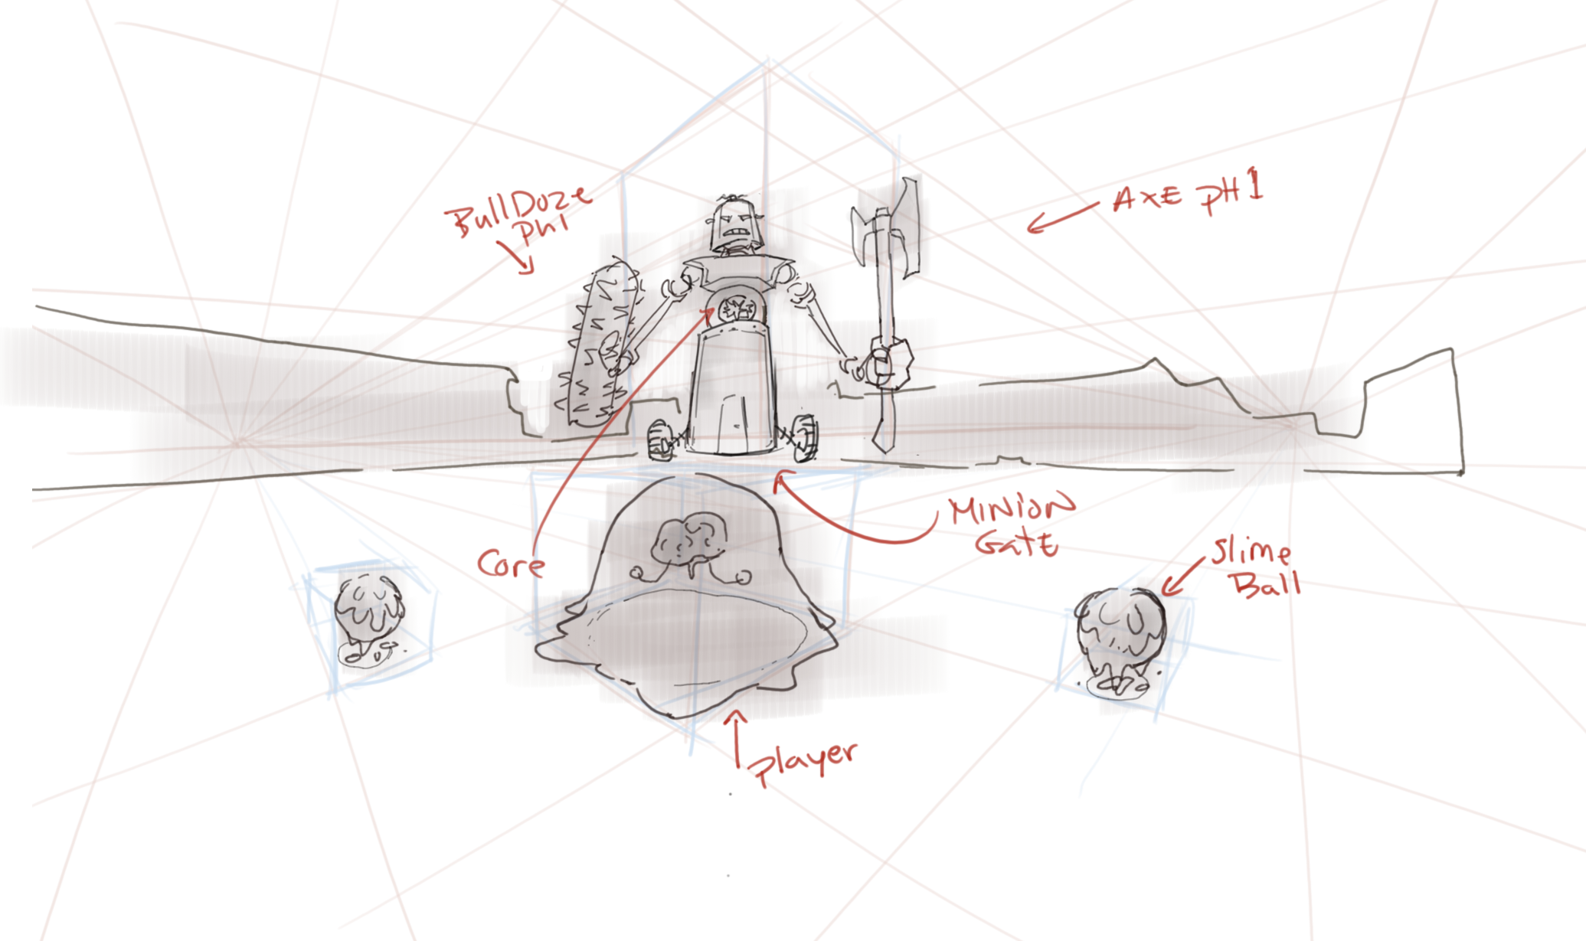
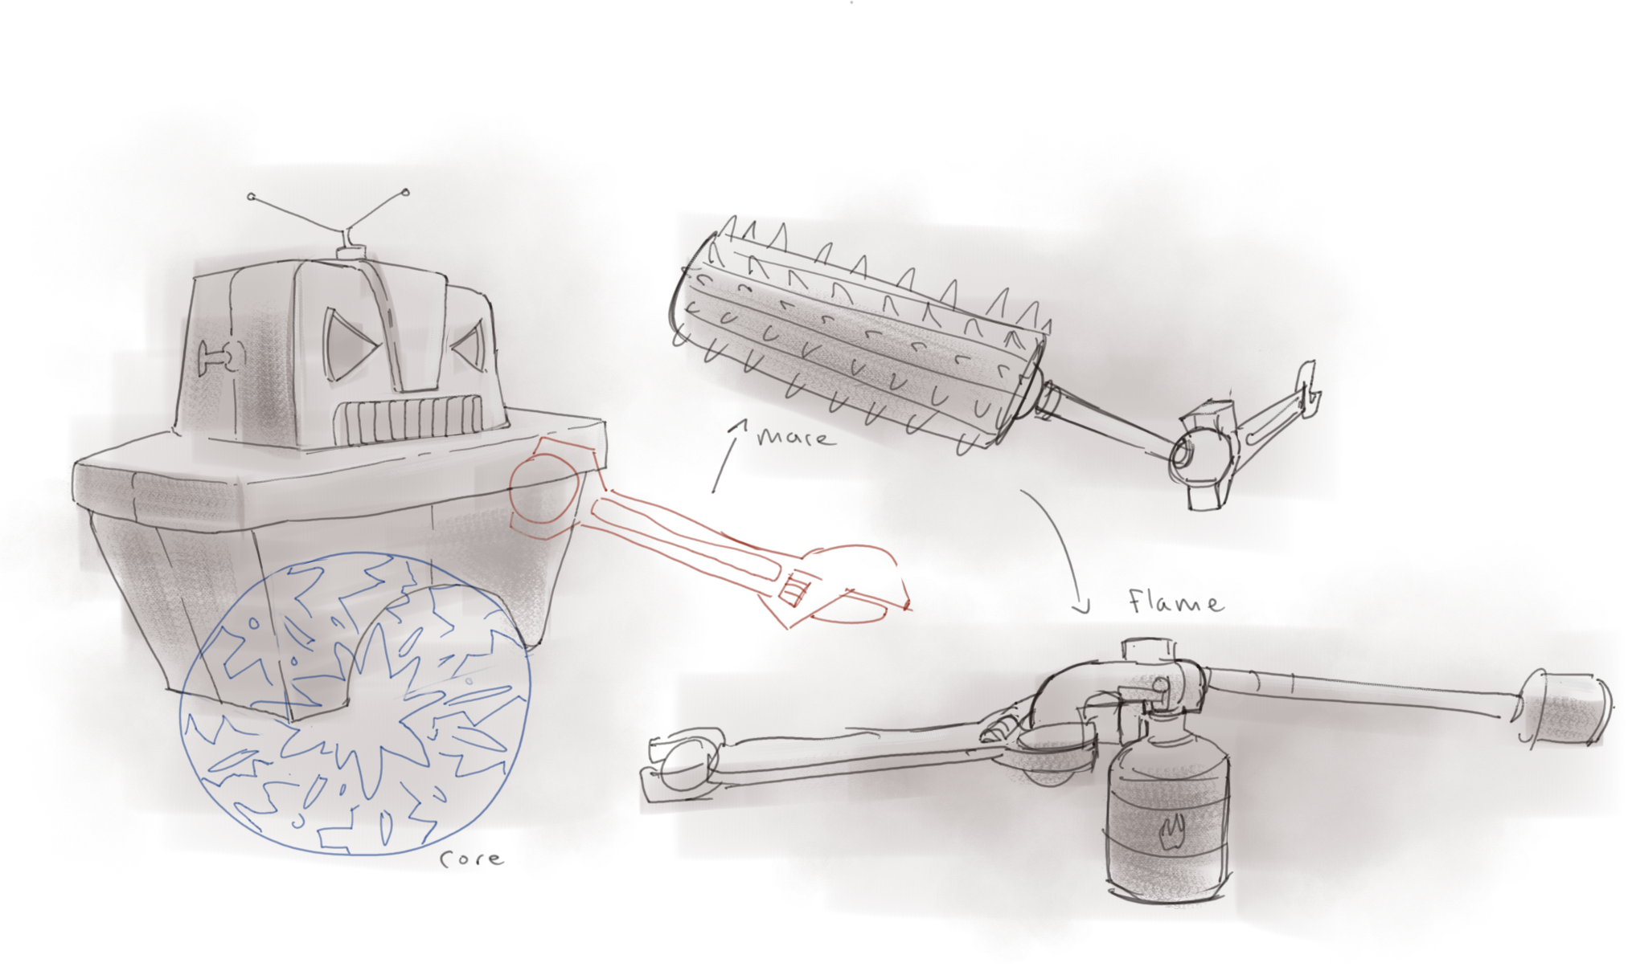
Fight Flow Predict/tell – Choose size – engage – reposition - resize
Saw Sweep + Magnet Grapple
Boss swaps arms:
Welder heat
Saw
Spiked roller
Counter:
Split to leave a decoy blob
Absorb matter to regrow
Counter: go small to slip gaps, and dash across

Slide 4
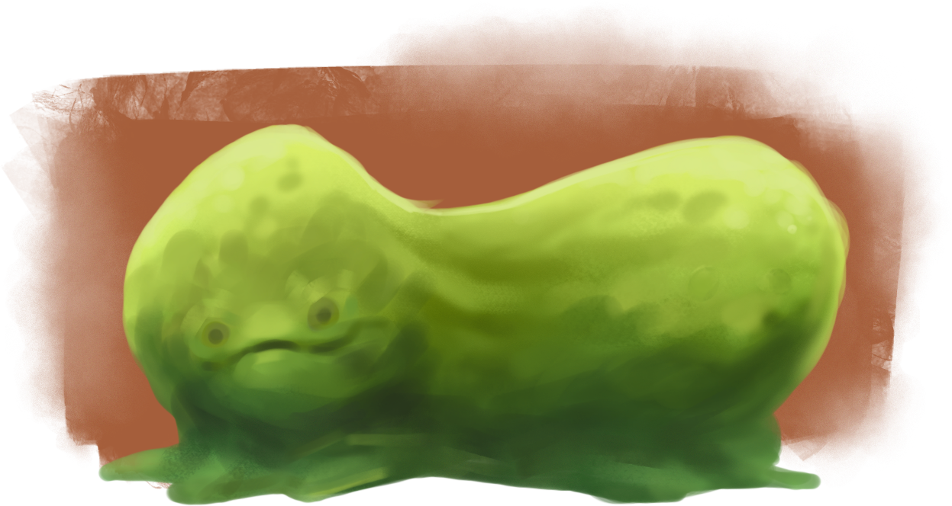
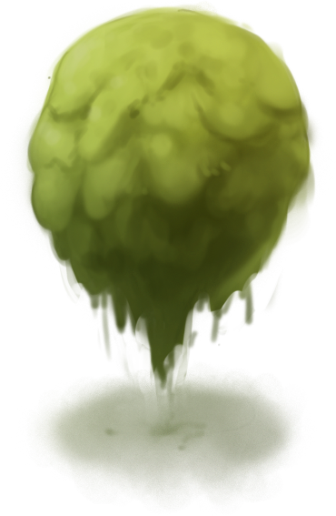
Skill expression
Size calls: when to go tiny burst VS safe and large
Blob setup: split before tells, then re absorb blobs (if not destroyed)
Mass economy
Speed/momentum mastery

Slide 5
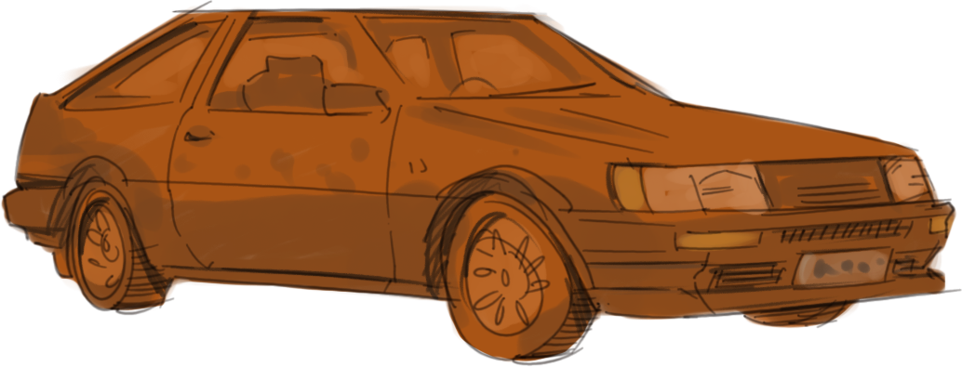
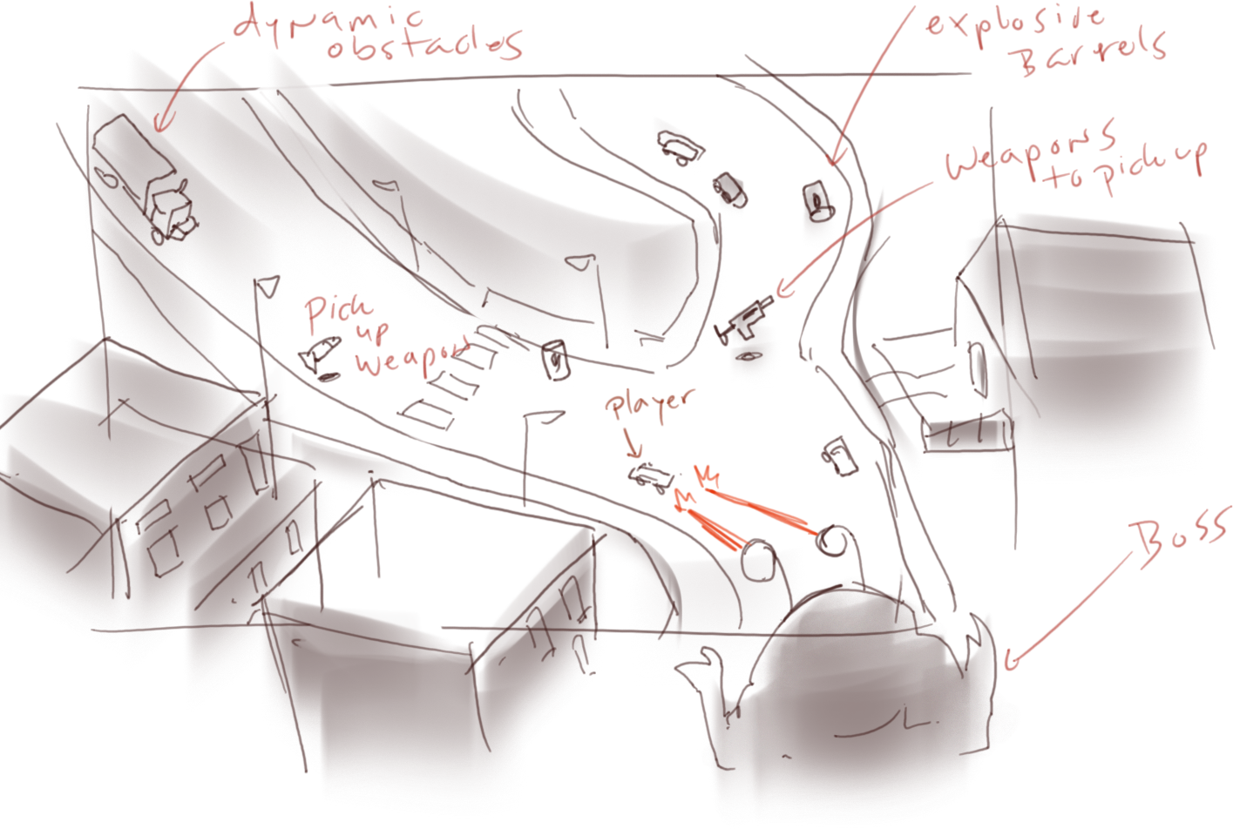
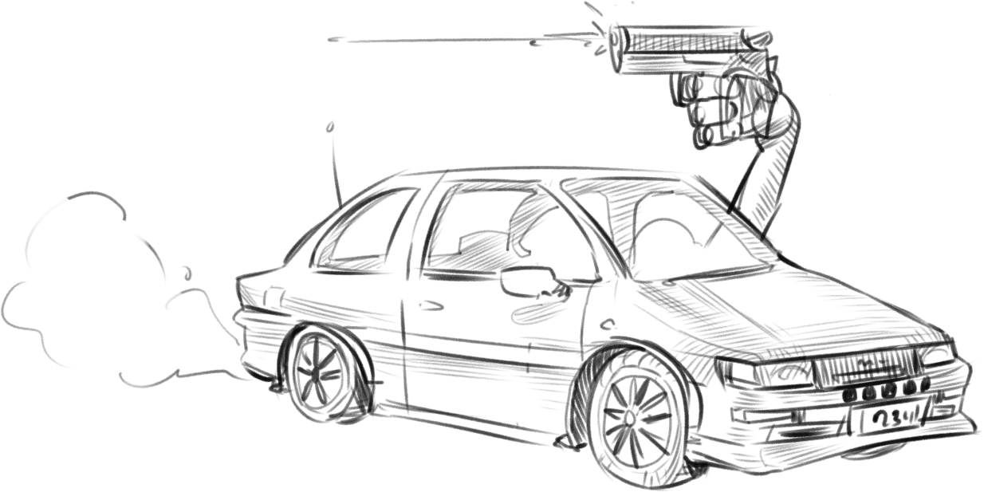
Game Concept 2: ‘Tokyo park’
Top-down arcade chase: outrun, outdrive, outgun a city-wrecking alien.
Drive/Drift
Scavenge/Equip
Throw/Trigger
Tricks = damage multiplier
Win = boss dead.
Lose = you die or City integrity hits 0.

Slide 6
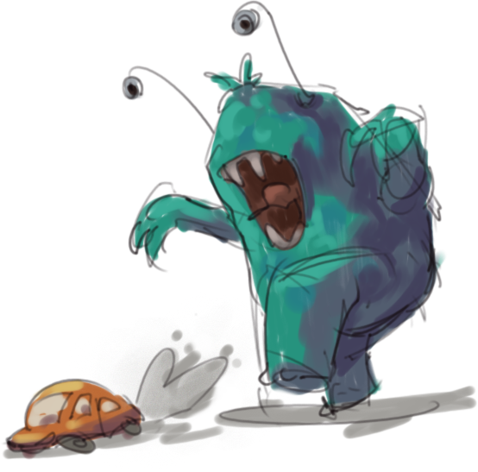
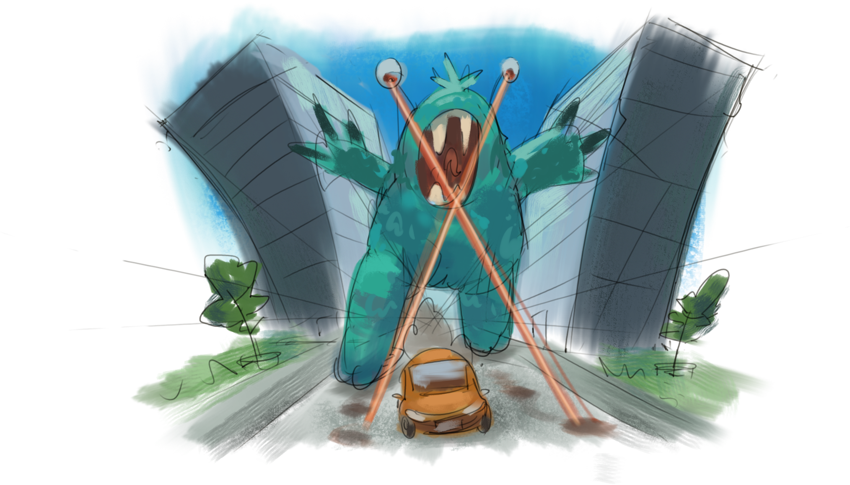
Fight Flow (attacks - Counters, phases, style)
Counter
Tell
keep moving
lane swap/jump over
Claw
Laser lock
break line if sight/stagger
Tail sweep
nitro boost
States: Hunt → Lost(shake aggro) →
Enraged (faster, bigger tells)
Loop: Hunt → stagger → Burst → Break line of sight → Repeat

Slide 7
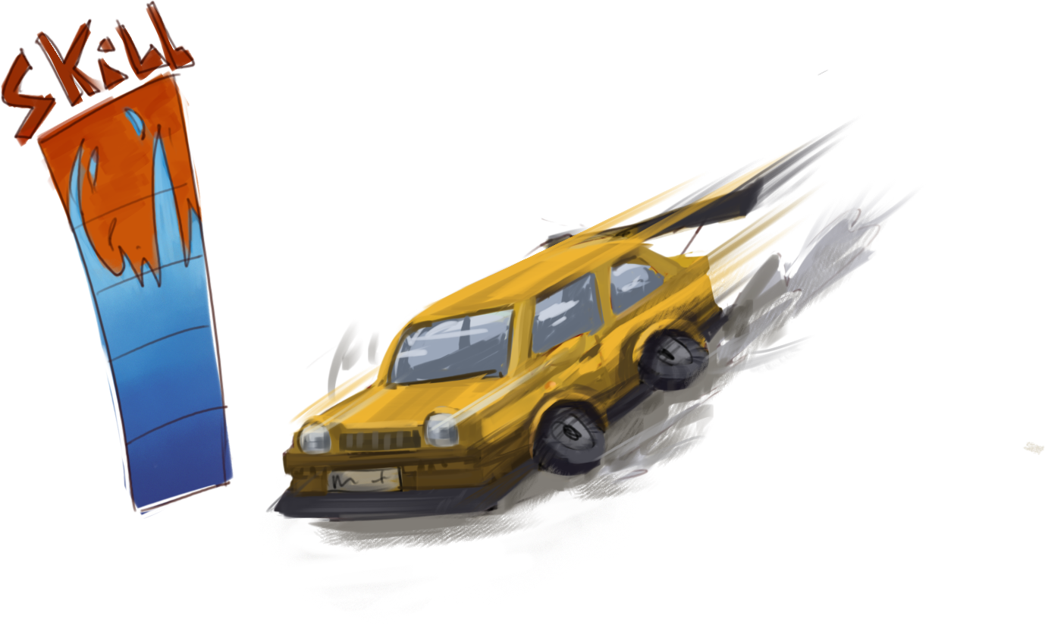
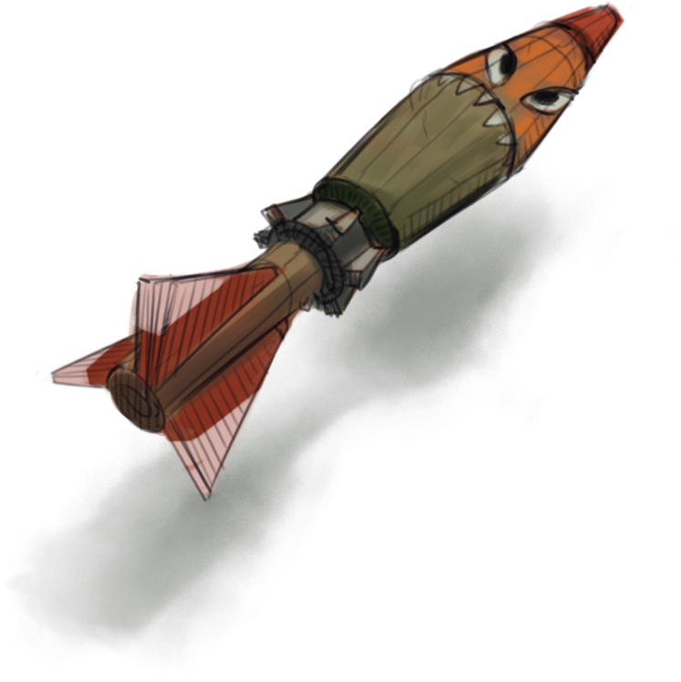
Skill Expression
Style = Power
Routing = Survival
Timing: fire rockets at higher style rating or play safe.
Build Style: chain drifts/jumps/near-misses = higher DPS
Route choice: safe highway VS risky alleys

Slide 8
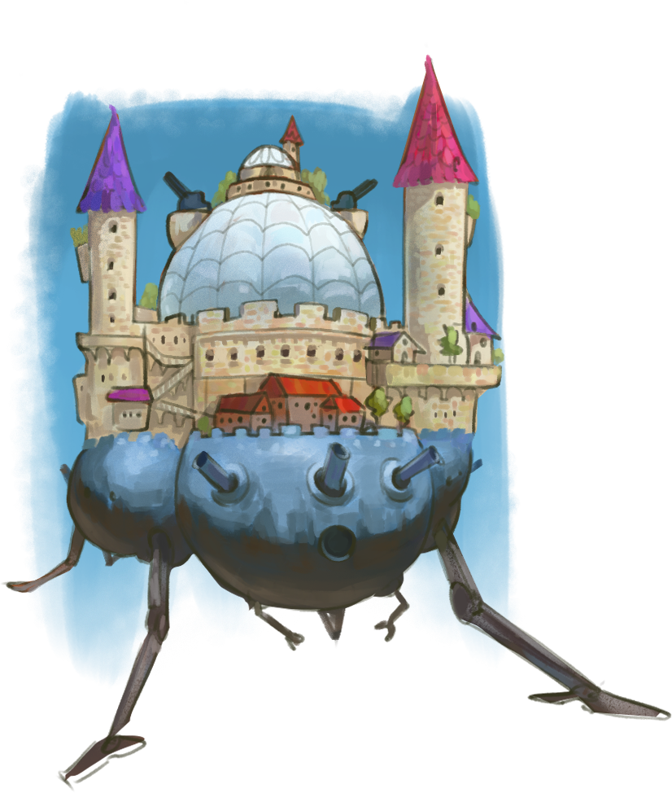
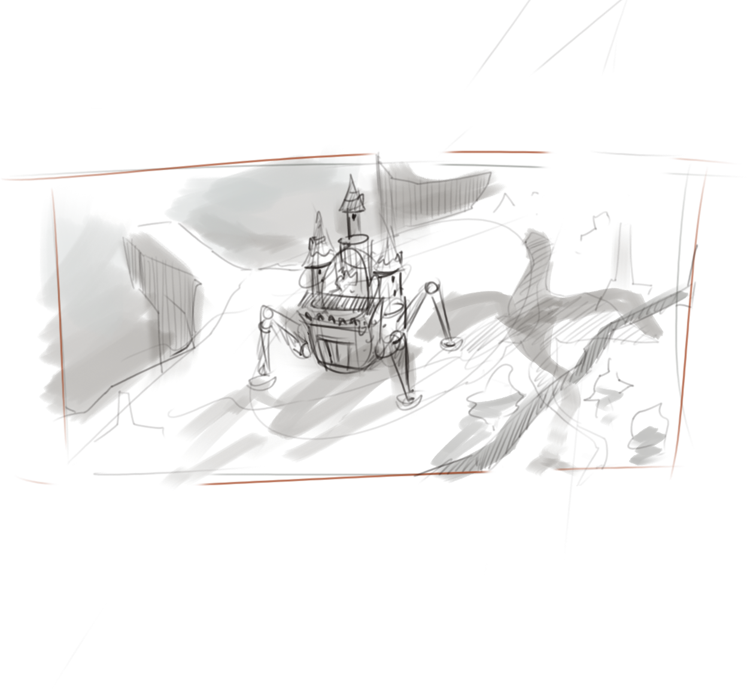
Game Concept 3: ‘Meandering siege’
Mobile Siege: Walking Castle Vs Dragon
You build on the move while the dragon hunts you
Dragon harasses you and the final fight tests your build
Win by grounding the dragon and finishing it.

Slide 9
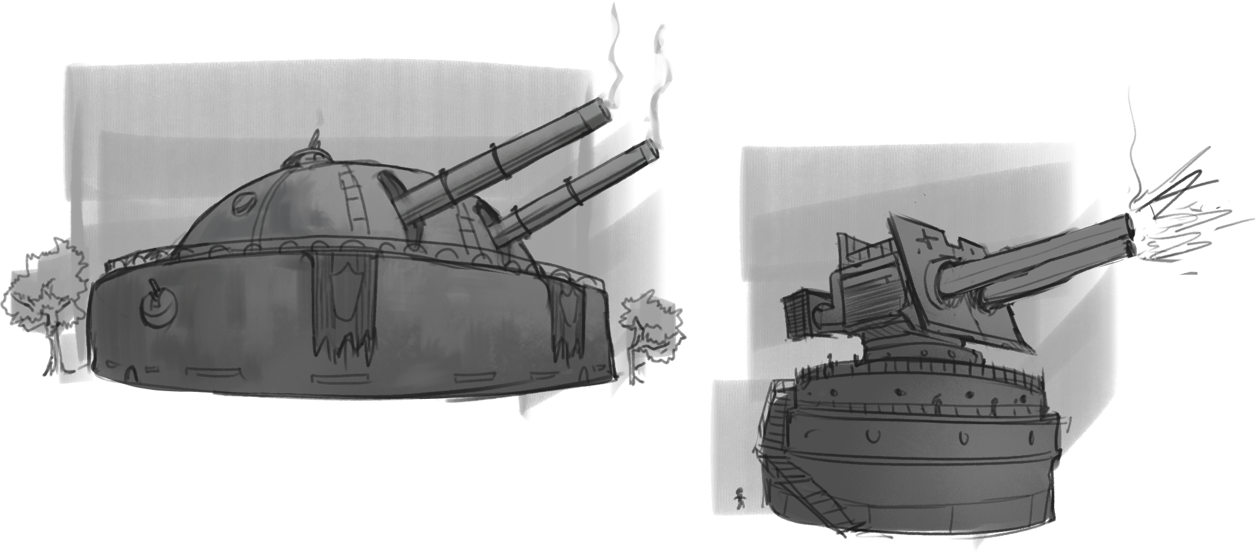
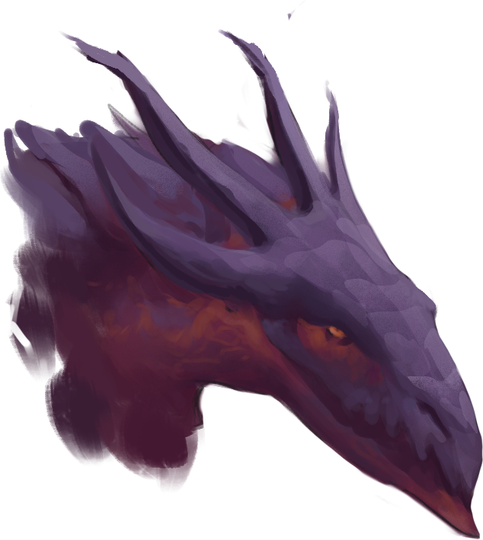
Fight Flow (Roam – Harras – repel – build/advance – repeat - final showdown)
Roam
Deal enough damage to make it retreat
Free movement
Clear enemies
Gather parts
Find safe route
You build on the move while the dragon hunts you

Slide 10
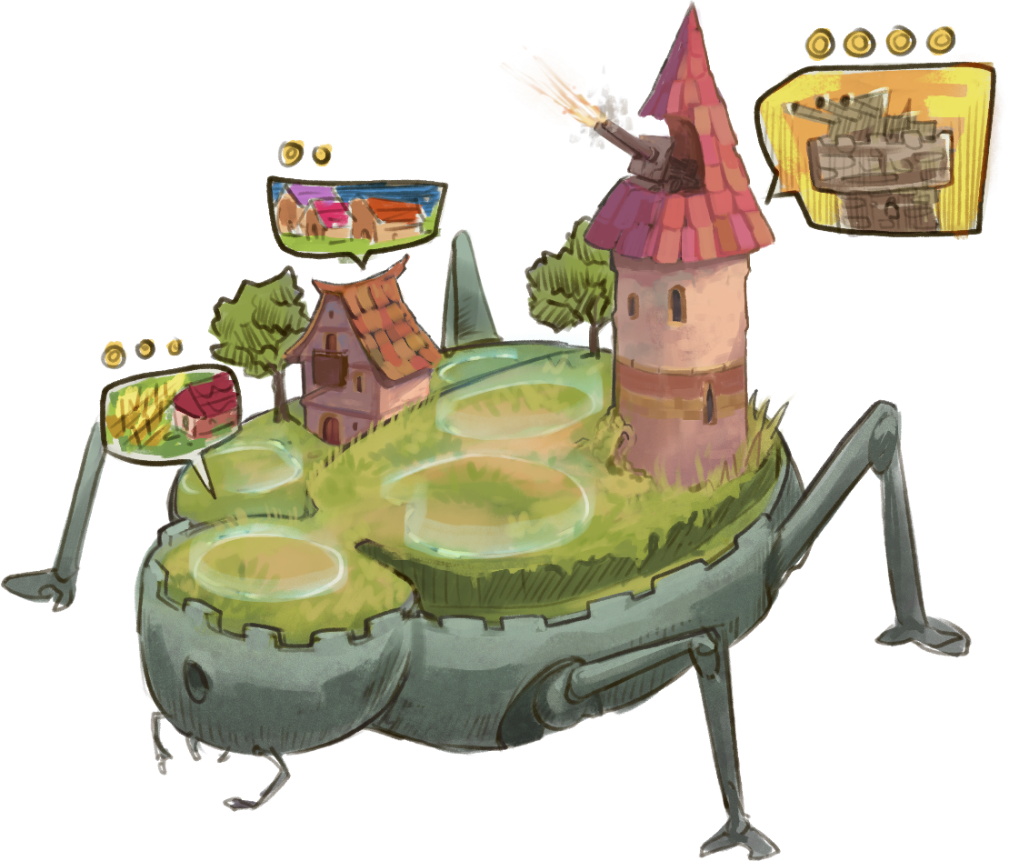
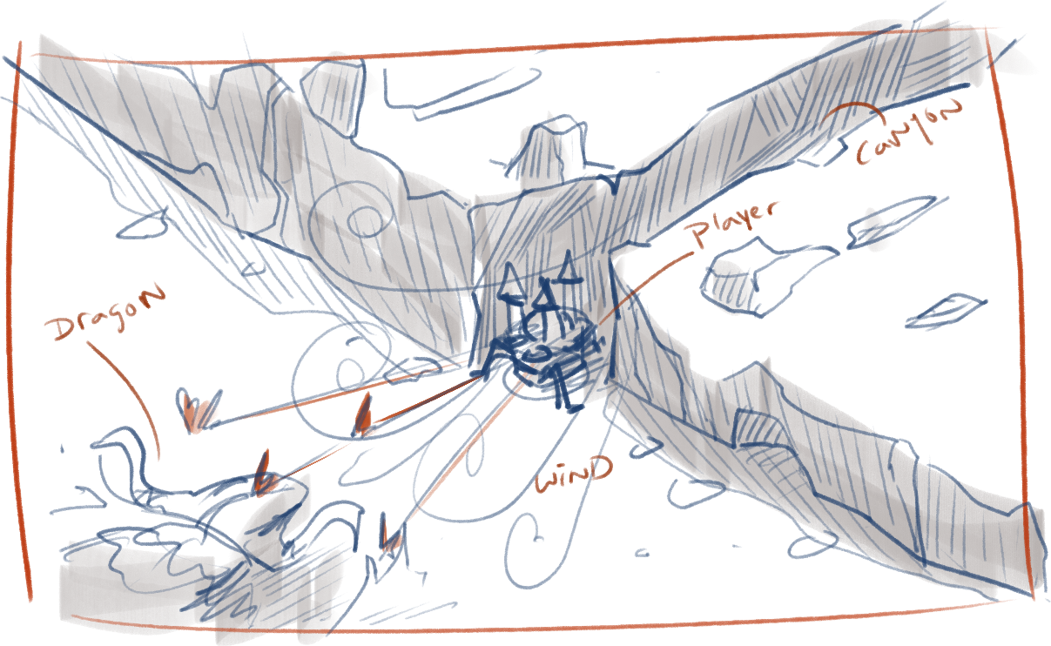
Skill Expression Smart windows. Smart routes. Smart builds
Time Window management
Routing
Do just enough to repel fast,
Use cover, wind lanes, choke points
then use the time well
Build timing
Install/upgrade during rest window

Slide 11

Thank u!

